Slide 1
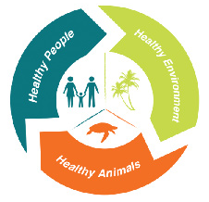
One Health: What is it and Why is it so relevant to today’s health challenges?
What is One Health?
Why should we practice One Health?
Why is One Health so relevant to today’s health challenges?
Examples - Health challenges that need a One Health approach
What are we doing to promote One Health in the Caribbean
Professor Chris Oura,
University of the West Indies, Trinidad and Tobago
chris.oura@sta.uwi.edu
French Red Cross PIRAC Webinar
28th March 2023

Slide 2

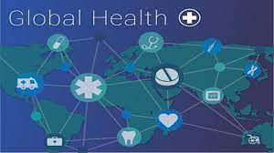

Finding solutions to difficult, cross-sectoral problems affecting human, animal, agricultural and environmental health through a transdisciplinary approach.

Slide 3
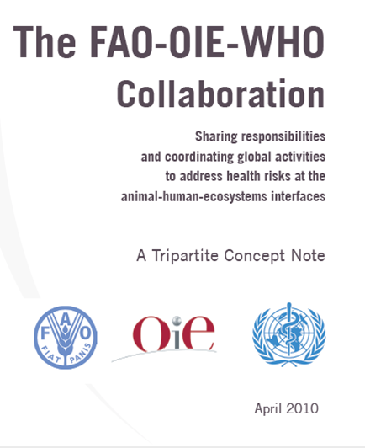
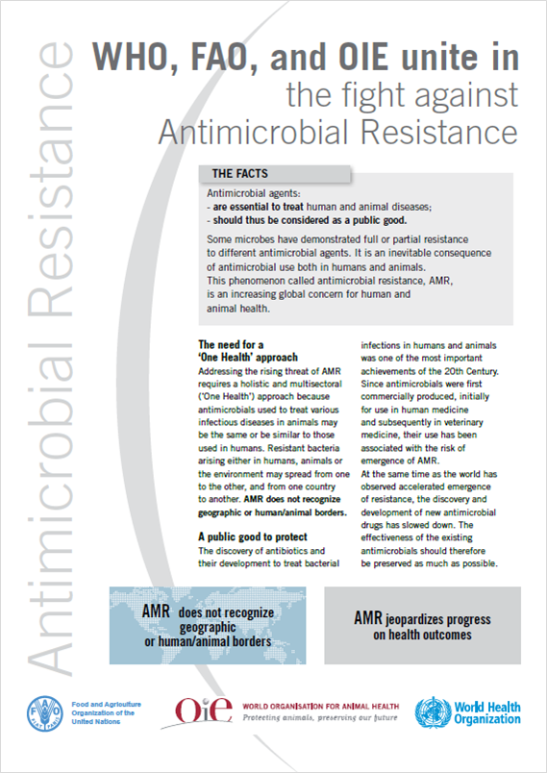
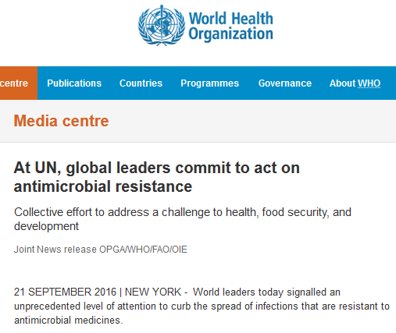
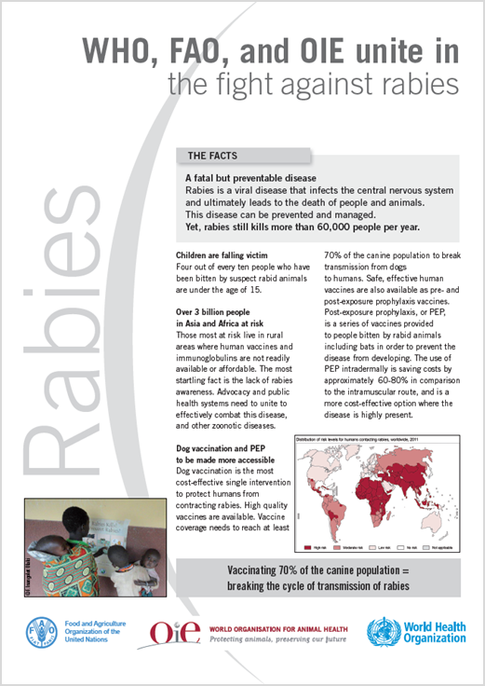
The International Health organisations are united behind a ‘One Health’ approach
The time is right

Slide 4
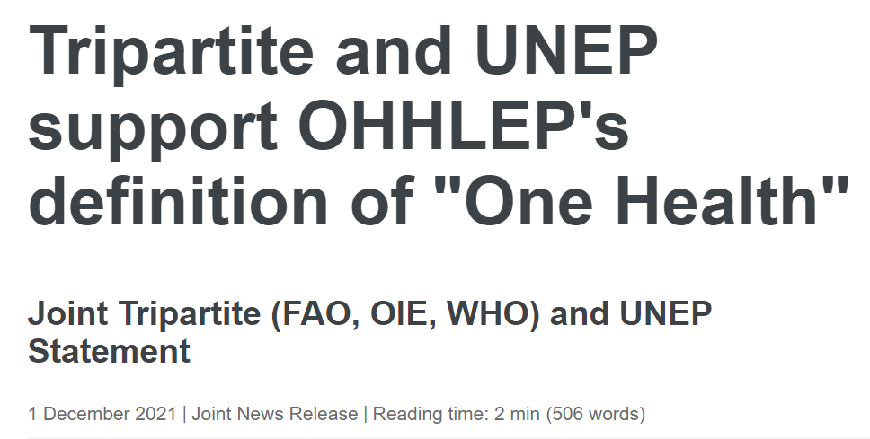
One Health is an integrated, unifying approach that aims to sustainably balance and optimize the health of people, animals and ecosystems.
It recognizes the health of humans, domestic and wild animals, plants, and the wider environment (including ecosystems) are closely linked and inter-dependent.
The approach mobilizes multiple sectors, disciplines and communities at varying levels of society to work together to foster well-being and tackle threats to health and ecosystems, while addressing the collective need for clean water, energy and air, safe and nutritious food, taking action on climate change, and contributing to sustainable development.

Slide 5



Recognising the connections among the health of people, the environment and animals / agriculture
Who needs to be around the table to solve the problem ?

Slide 6

Who needs to be around that table?
Policy Input Governments and funding bodies
Animal (domestic / wildlife) Input Research / disease expertise
Human Input
Research / disease expertise
Entomology Input
Research / expertise (vector control)
Issue to address
Pharmaceutical Input
Vaccine /drug development
Environmental Input Impact of climate / land use change
Social Input
Impact of disease on communities
Economic Input
Impact of disease on communities

Slide 7

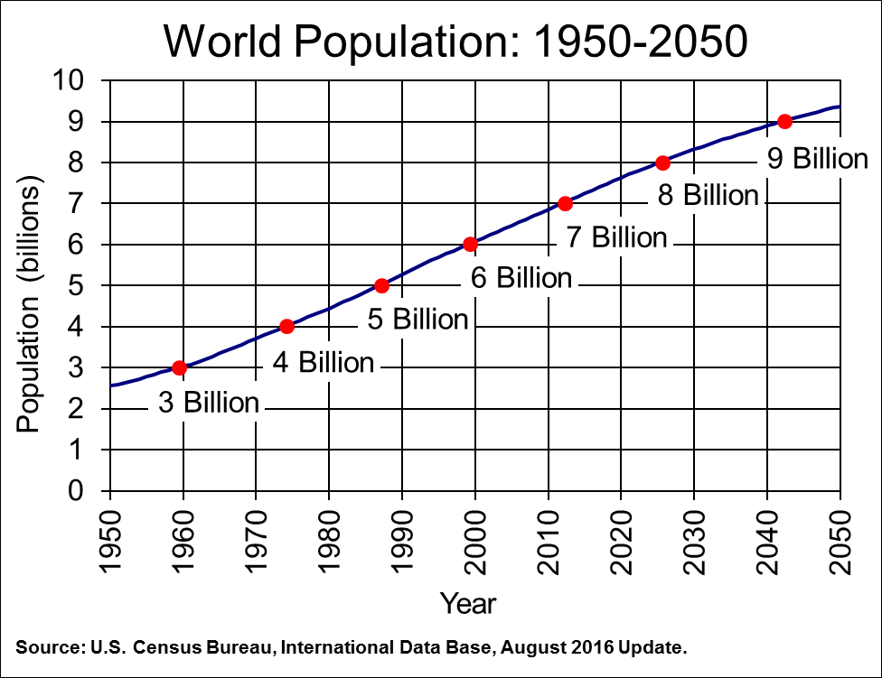

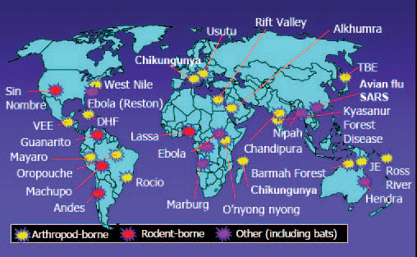
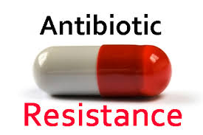
There is an urgency to act now, now, now

Slide 8

Four major complex and ‘wicked’ health issues that demand a ‘One Health’ approach
Globalisation - the emergence of zoonotic diseases
Antimicrobial resistance (AMR)
Food and water security (and safety)
Global warming / Climate Change

Slide 9


The emergence of zoonotic diseases
Most human pathogens have come through animals
Animals often maintain pathogens in the environment – wildlife
Animals are involved in the spread of the pathogens to humans
Environmental factors are linked to the spread of many pathogens
Need to follow a multidisciplinary “One Health” approach

Slide 10



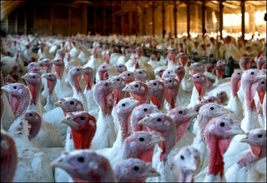

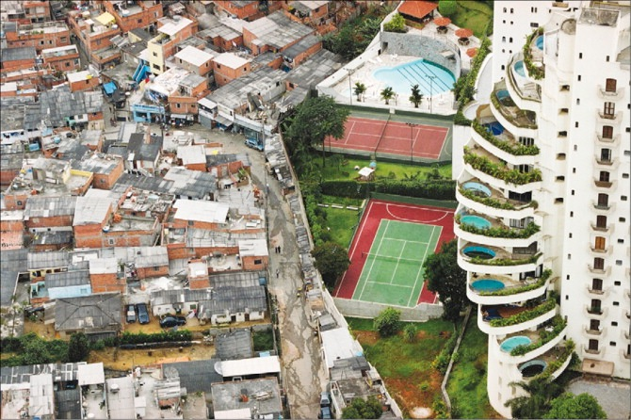
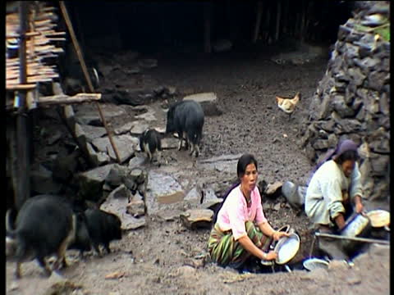

Majority of disease emergence is driven by ecological, economic and social factors associated with human activity
Rapid global transport networks
    Deforestation forest encroachment
Modern agricultural practices
High density human populations unplanned urbanisation
Close association between humans animals –
often driven by poverty

Slide 11
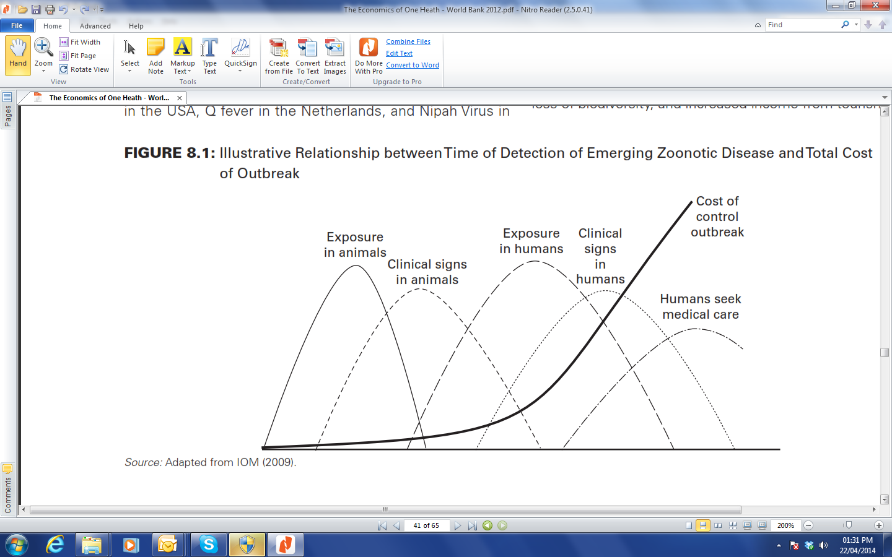
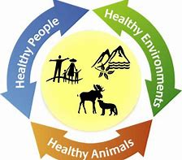
BIG lesson we need to learn
One Health
World Bank (2012)
Source: Adapted from IOM (2009)

Slide 12
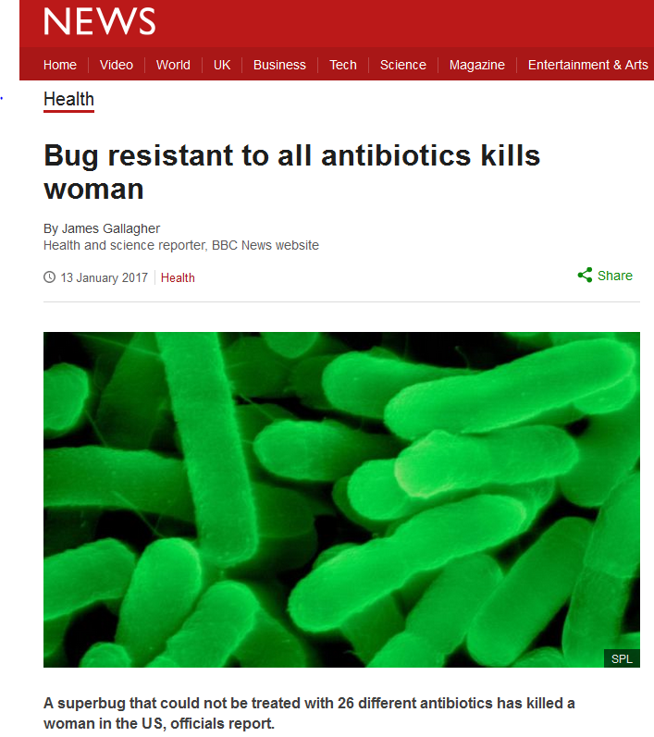
A “One Health” approach to antimicrobial resistance (AMR)

Slide 13
A “One Health” approach - Antimicrobial Resistance (AMR)
Human Input
Doctors / Dentists / Pharmacists / Nurses
General Public
Policy Input Governments, NGOs International organisations, funding bodies
Animal Input
Vets, animal technicians, farmers, livestock industries
Academic Input
Education
Communication
Understanding
Research
Action plan to address Antimicrobial Resistance (AMR)
Pharmaceutical Input
Quality Assurance
Development of new antibiotics
Environmental Input
Antibiotic residues in the environment – food / soil
Social Input
Develop a social case for sustainable investment
Economic Input
Develop the economic case for sustainable investment

Slide 14




“Our BIG Challenge”
To promote and entrench a “One Health” approach to help solve some of the major health issues facing the Caribbean.
“Changing the way people think about health issues”
Top down approach
Bottom up approach
One Health
Community engagement

Slide 15
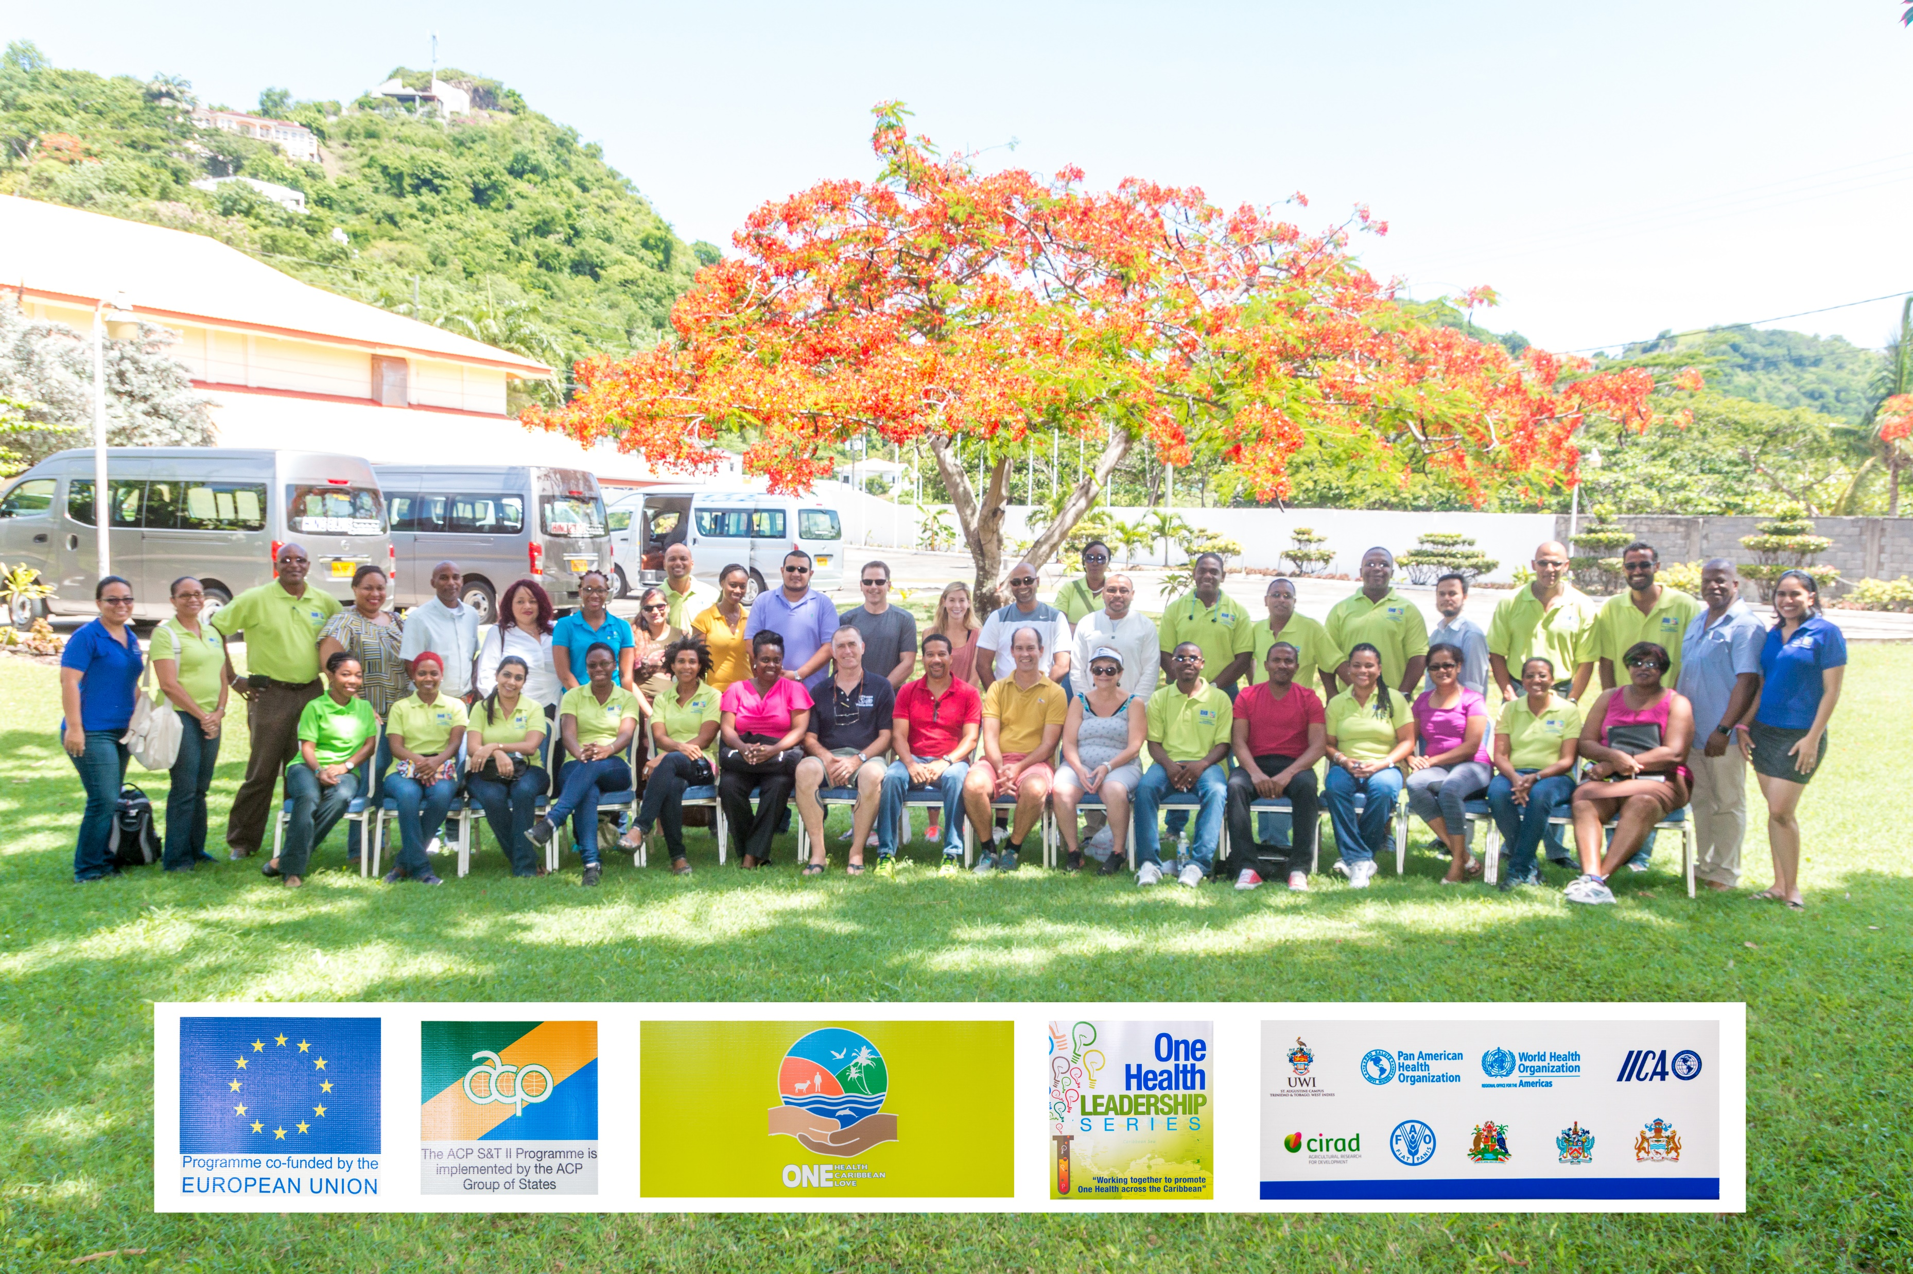
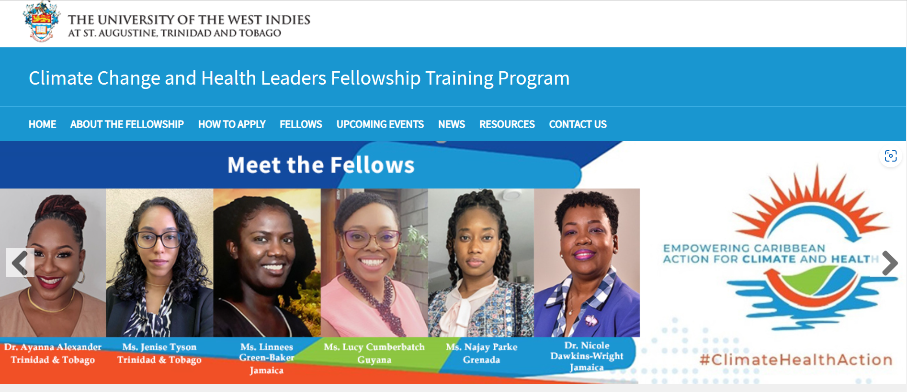
Building networks of Caribbean Professionals to effect change:
One Health Leadership Series:
30 One Health Leaders
12 Caribbean countries
Climate Change and Health Leadership Fellowship Program:
Climate Change and Health Leaders
16 Caribbean Countries
https://sta.uwi.edu/fms/cch/
https://www.youtube.com/watch?v=0mL29J_J_bk

Slide 16
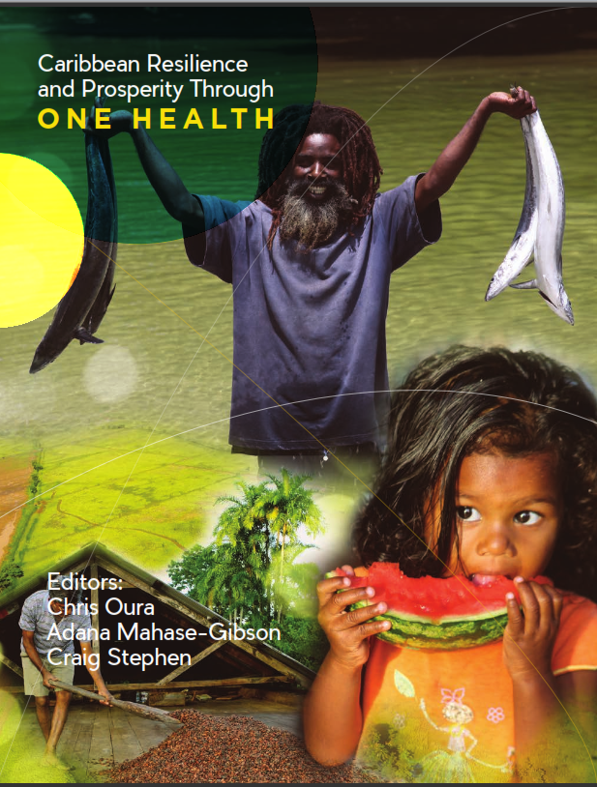
Thanks for Listening!
Application for 4th cohort of Climate Change and Health fellowship will OPEN in November 2023
Application information can be found at:
https://sta.uwi.edu/fms/cch/
Please feel free to contact us for any more information:
Stacey Adams - CCH.Fellowship@sta.uwi.edu
Chris Oura - chris.oura@sta.uwi.edu
One Health Book Link:
https://collaboratif.cirad.fr/share/s/84vh-nPvSJWzrjnptvjF6Q

