Slide 1
MalaKIT/Curema:
Innovative interventions for malaria elimination in forests
Notes:
Mail à Kamel

Slide 2

Dr Maylis Douine
Centre d’Investigation Clinique Antilles-Guyane
Inserm 1424
Hôpital de Cayenne
Guyane
March 28, 2023

Slide 3
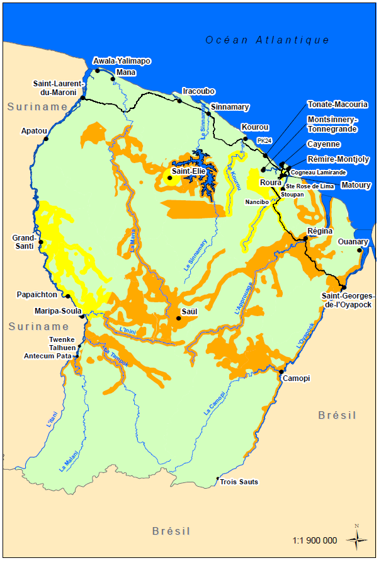
Malaria challenges in French Guiana in early 2010's
>1 000 cases/year
Indigenous population
Illegal gold miners
Military personnel/Foresters
Musset 2014

Slide 4
Specific studies: Major transmission intensity on gold panning sites
2014 Eaux-Claires (SSA)
PCR prevalence: 46%
P. falci: 70%
2015 Orpal (CIC)
Malaria prevalence: 22%
P. falciparum: 60%
Self-medication: 52%
With ACT: 90%
ACT=Artemisinin-based combination therapy
Black-market medication could lead to artemisinin resistance
Pommier de Santi 2017
Douine 2016

Slide 5

Under-detection of forest malaria in the surveillance system
258 cases detected in French Guiana
947 symptomatic cases identified
215 cases diagnosed in Suriname
474 cases diagnosed in Brazil
Unknown number of undiagnosed malaria attacks in the forest
1,500 to 2,250 asymptomatic carriers?
Similar findings in Eaux-Claires. Literature shows that asymptomatic malaria carriers are transmitters (probably less but longer) up to 200 days (Felger)
Surveillance 2016: CIRE Guyane, Malaria program Suriname, Malaria program, Brazil
Assessment of asymptomatic carriers: Orpal Study 2015

Slide 6
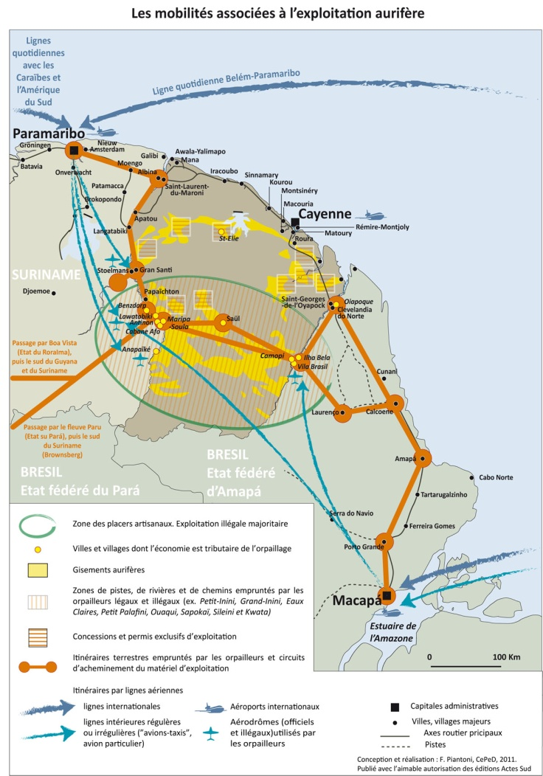
Public health issues (2015)
Mobility associated with gold mining
Risk of malaria spreading in the region
Risk of emergence of parasites resistant to ACT
ACT=Artemisinin-based combination therapy

Slide 7
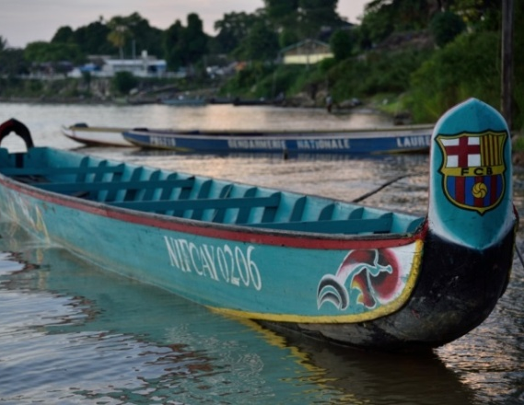
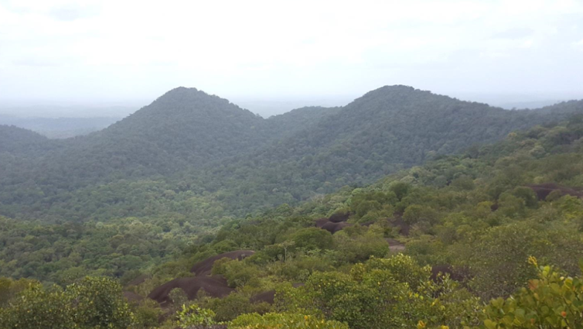
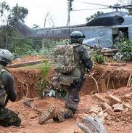
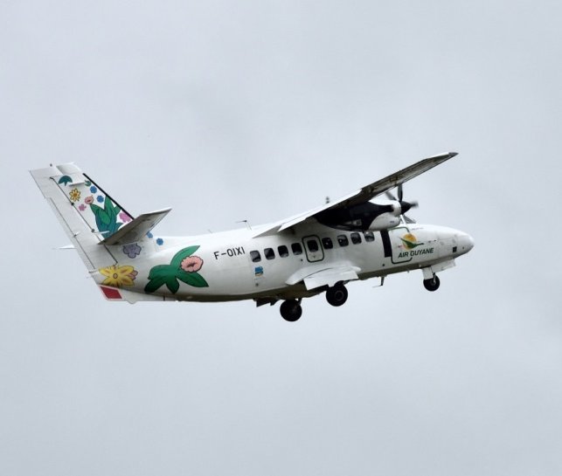
How to reach these populations?

Slide 8
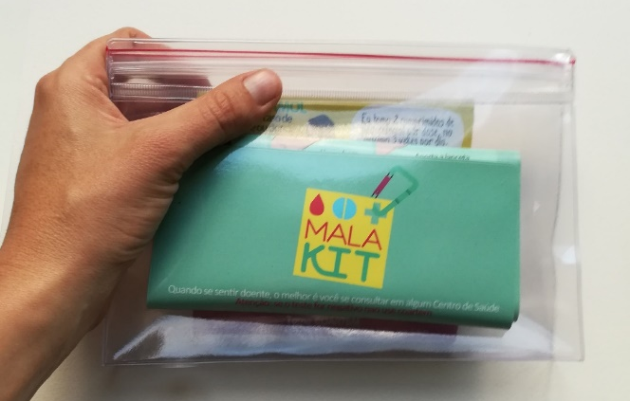
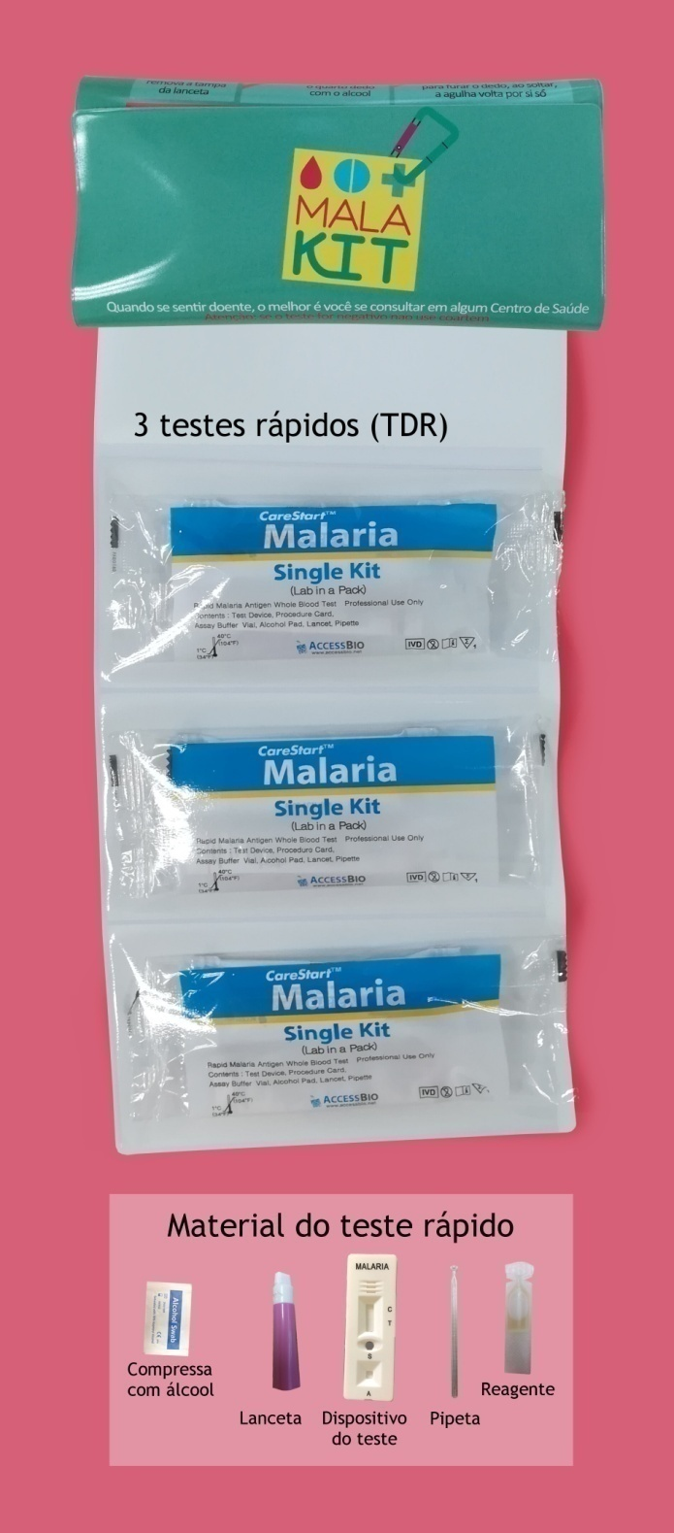
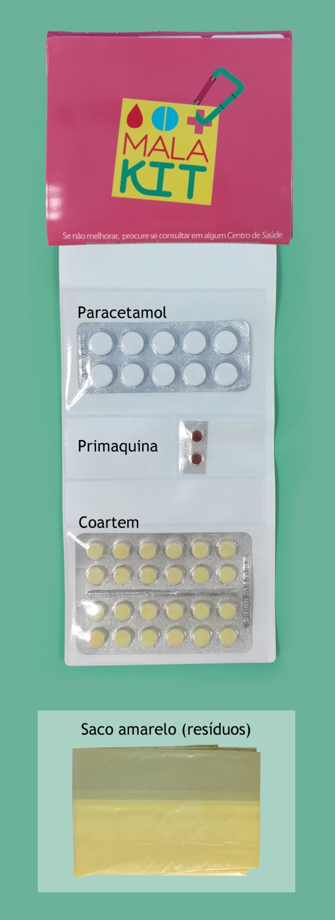
The MalaKIT Project (2018-2020)
Self-diagnosis and self-treatment of malaria
In a plastic pouch:
3 rapid diagnostic tests
Full course of AM/LM combo + primaquine 15mg
Paracetamol
+ long-lasting impregnated net
AM/LM=artemether 20mg/lumefantrine 120mg

Slide 9
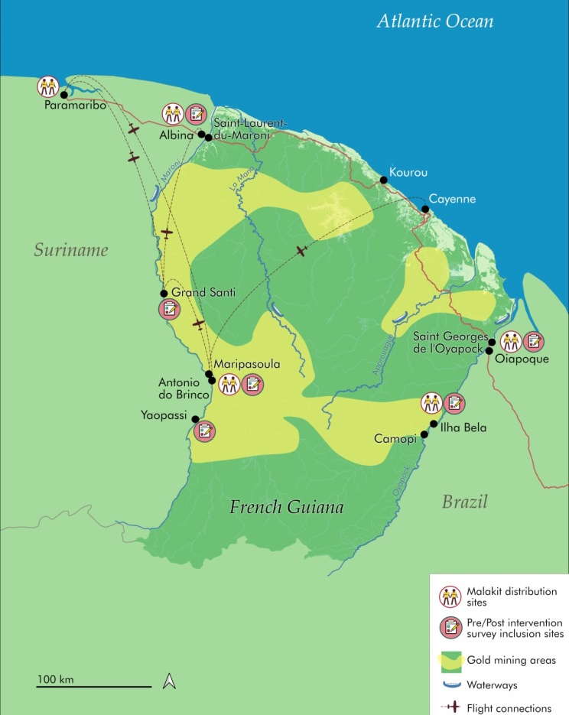
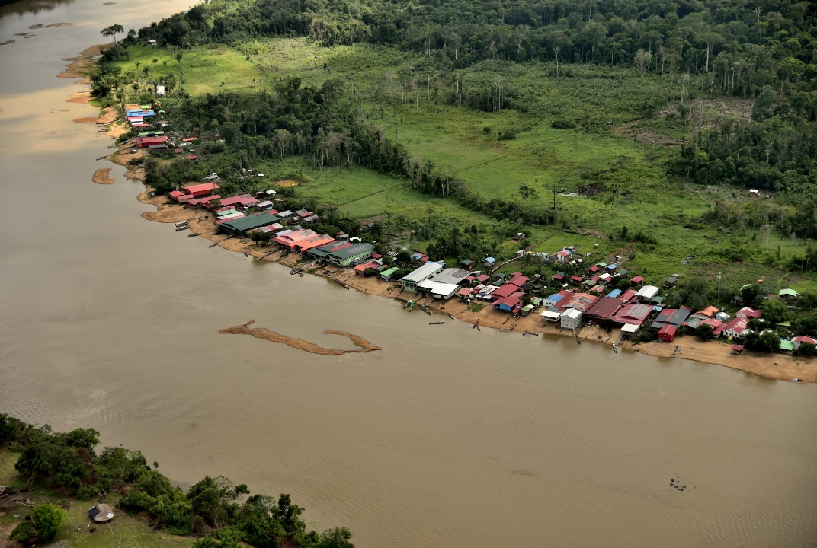
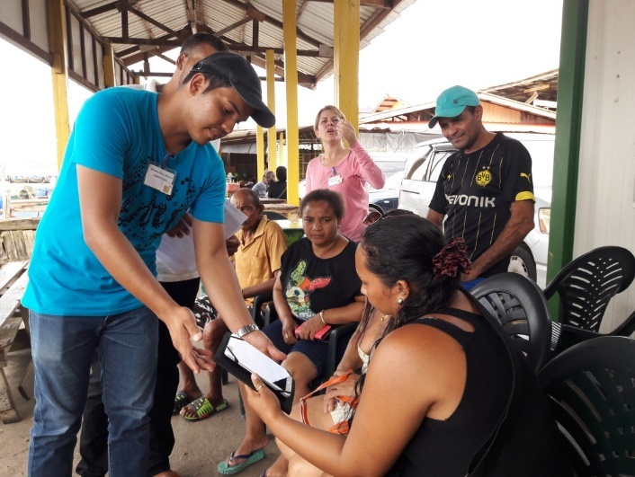
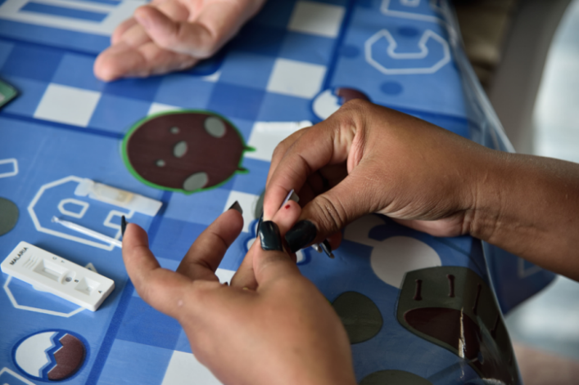
Training & MalaKIT distribution
Logistical back-up bases
2 borders
Permanent health mediators

Slide 10
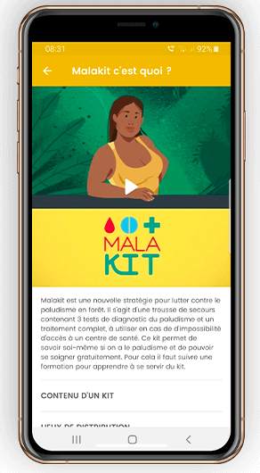
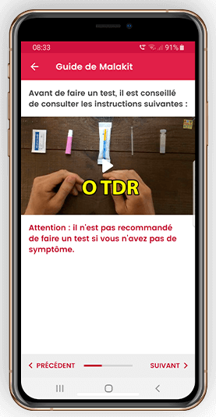
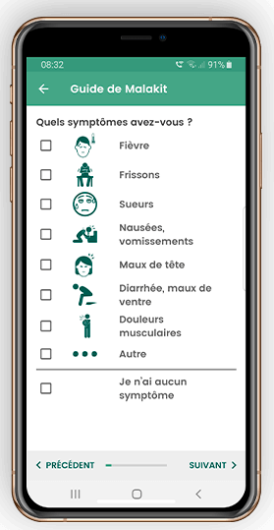
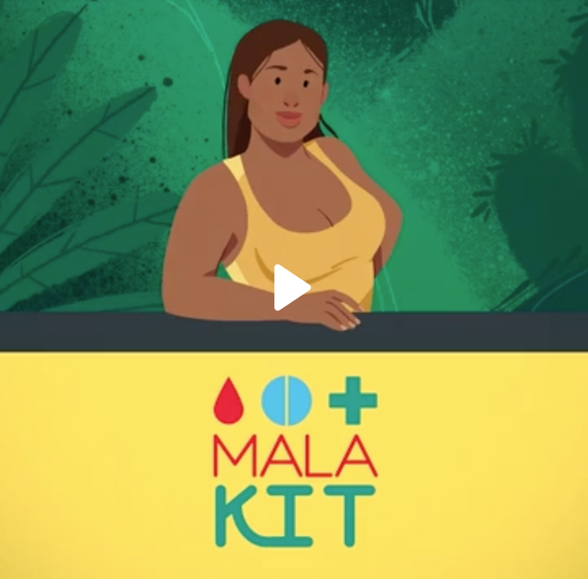
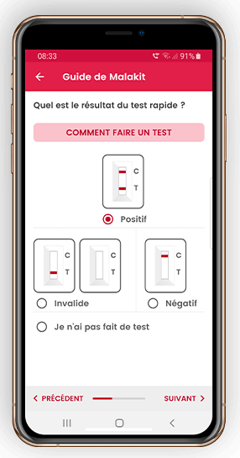
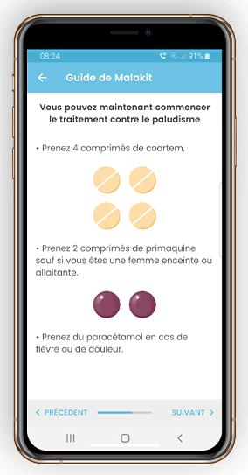
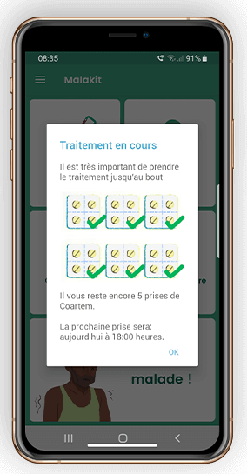
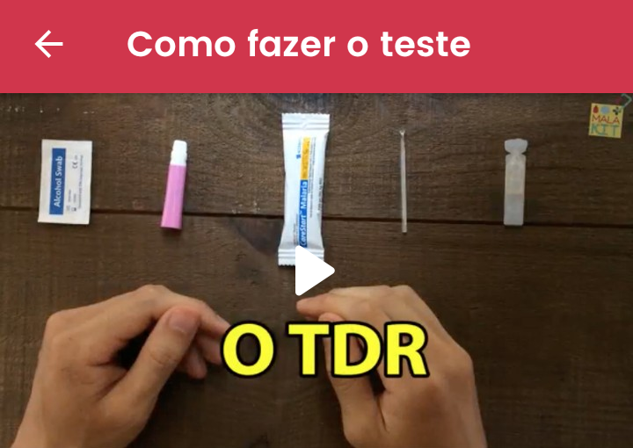
Adapted training tools

Slide 11
DESIGN: Interventional study
Objective:
Provide the study population with the equipment and resources needed to handle an episode of malaria symptoms by themselves, when they are in an isolated location
MalaKIT Intervention
Qualitative evaluation (survey):
Mediators/gold miners
PRE-
INTERVENTIONAL
STUDY
POST-
INTERVENTIONAL
STUDY
Adverse event monitoring
Mediators - smartphone application - health system

Slide 12
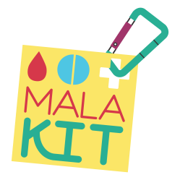
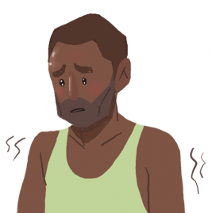
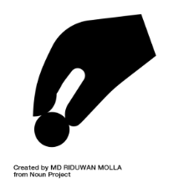
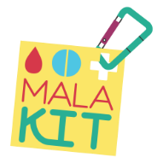

MalaKIT: Results from a 2-year interventional study (2018-2020) 1/2
4,766 kits distributed
3,733
participants
631
Follow-up visits
303
well-documented use of kits
30% of the population
70% of correct use
Douine et al, Lancet Reg Health-America 2022

Slide 13
MalaKIT: Results from a 2-year interventional study (2018-2020) 2/2
Increase in appropriate behaviors
OR=1.8 [1.1-3.0]
Decrease in the prevalence and % of P. falciparum
Douine et al, Lancet Reg Health-America 2022

Slide 14


Regional malaria epidemiology
P. vivax
P. falciparum + mixta

Slide 15
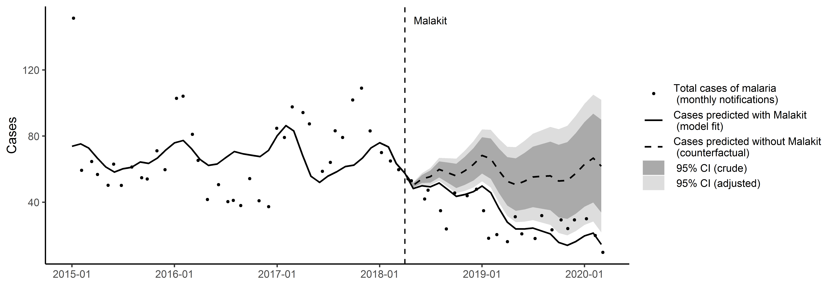
Impact on malaria incidence
Interrupted Time Series
MalaKIT helped prevent an estimated 43% of the cases of malaria imported from French Guiana to Brazil and Suriname between April 2018 and March 2020

Slide 16


The MalaKIT approach: Beyond research
Implementation in Suriname
  Via National Malaria Control Program
  Global Fund financing
  5 MalaKIT distribution sites
Brazil? France?
New challenge:
  P. vivax

Slide 17
P. vivax Reservoir issue
MalaKIT use
Need for a specific intervention

Slide 18

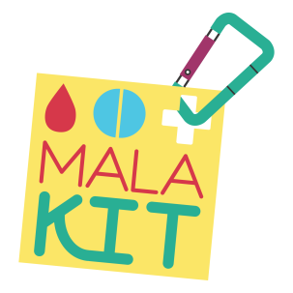

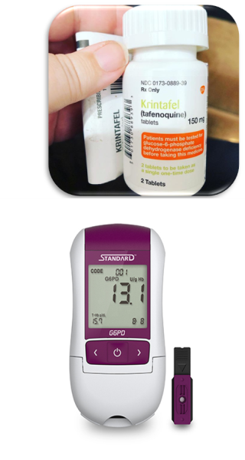
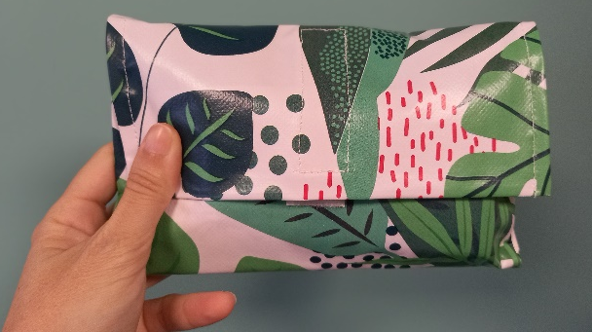
The CUREMA Project
Dr Alice Sanna
MalaKIT distribution
New design
Adaptation of IEC tools
Targeting of P. vivax hypnozoite carriers
Probability of carrying hypnozoites
Search for contraindication
  G6PC POC Biosensor
  Pregnancy test
Treatment with Primaquine/Tafenoquine
Adverse event monitoring
Objectives:
To reduce the prevalence of Pf and Pv malaria
To assess the feasibility and safety of the intervention

Slide 19
DESIGN: Interventional study
Objective:
To evaluate both the effectiveness of the intervention on malaria transmission (with a pre/post quasi-experimental design) and its implementation (with a mixed methods approach)
CUREMA Intervention
Qualitative evaluation (survey):
Mediators/gold miners
PRE-
INTERVENTIONAL
STUDY
POST-
INTERVENTIONAL
STUDY
Adverse event monitoring
Mediators - smartphone application - health system

Slide 20

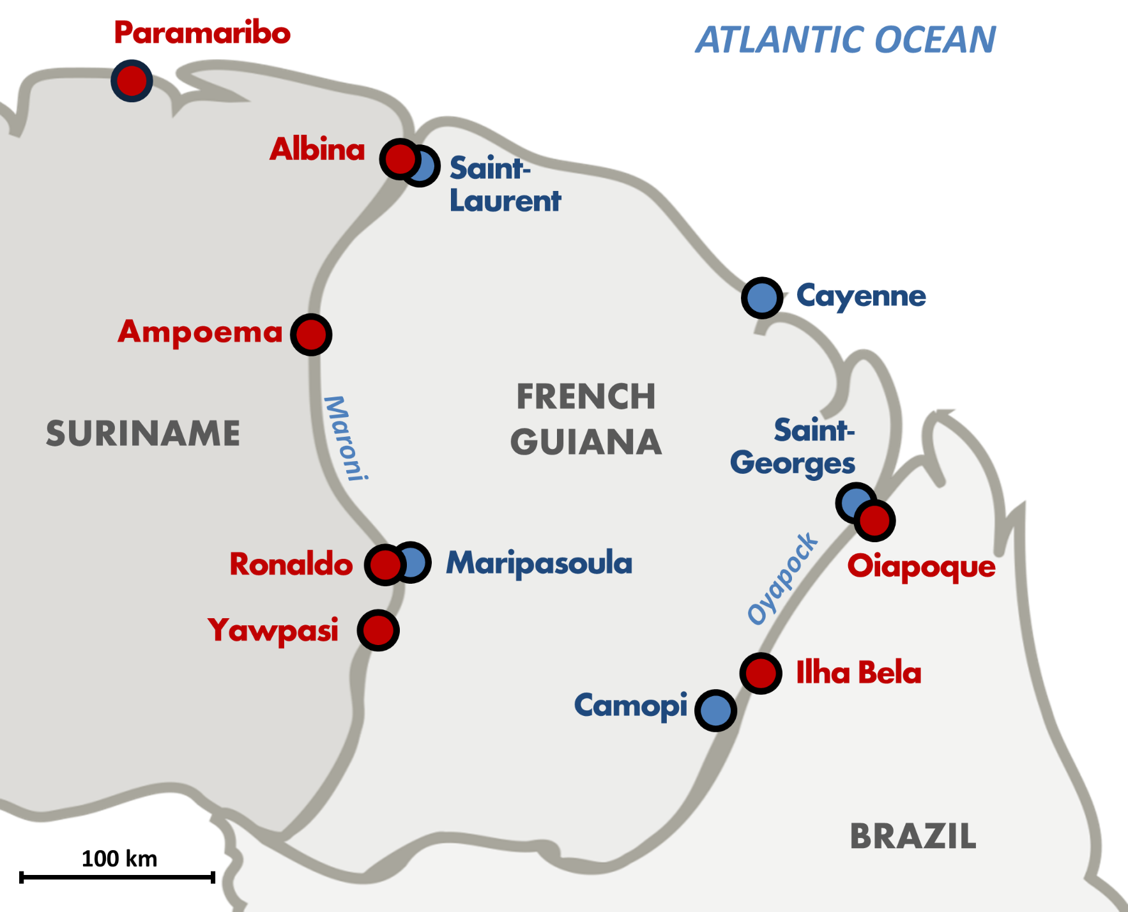
CUREMA Implementation
Maroni:
March 2023
Oiapoque:
July 2023
End of the study:
Q4 2024
Evaluation:
Cross-sectional studies
Before: end of 2022
After: end of 2024
(research beyond malaria)

Slide 21
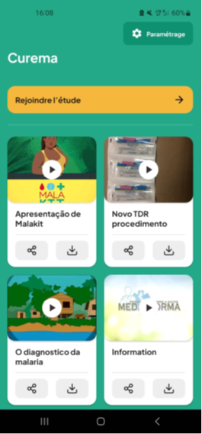
Adverse event monitoring
Telephone or face-to-face follow-up by mediator
Self-declaration by application
Importance of ensuring participant safety
Different benefit/risk balance for probabilistic treatment

Slide 22












Partners & Funders
PARTNERS
France
Ministère de la santé
ARS
IPP + IPG
CDPS
CTG
SCIENTIFIC PARTNERS: Mahidol University, IPCambodge, PAVE (USA), Heredia University (Peru)
FUNDERS
European Funds PCIA (CTG)
CNES
Ministère de la Santé/ARS
Global Funds through MoH Suriname
MoH Brazil
SURINAME
Ministry of Heath (Malaria Program)
Scientific foundation SWOS
BRAZIL
Ministry of Heath
Fiocruz
DPAC Association

Slide 23
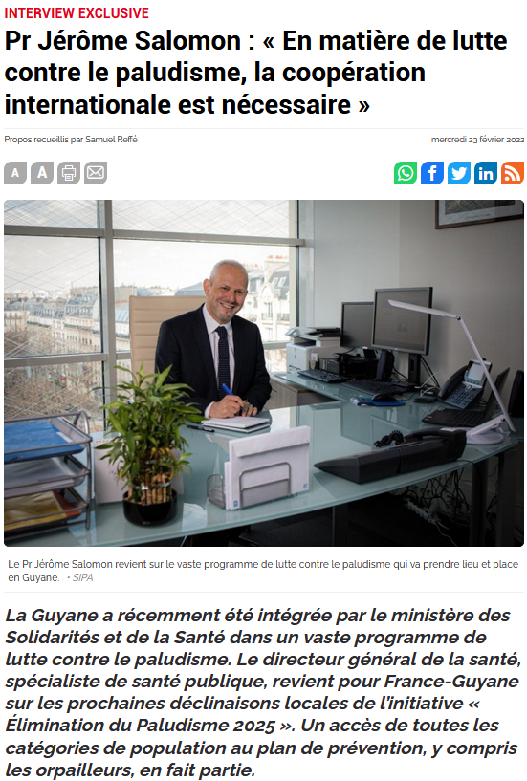
‘IN THE FIGHT AGAINST MALARIA, INTERNATIONAL COOPERATION IS NECESSARY’
Pr. Jérôme Salomon
Directeur Général de la Santé

Slide 24
Thank you!
www.malakit-project.org

